Slide 1


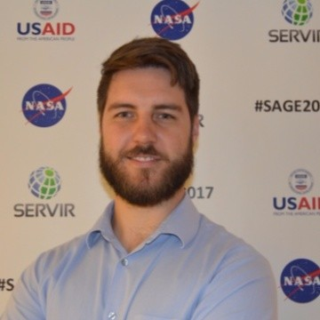
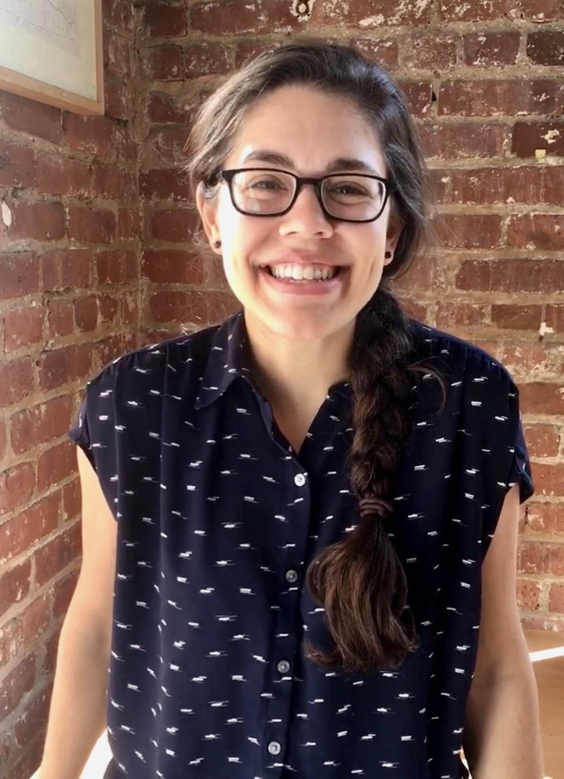

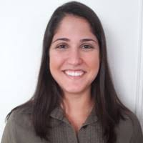
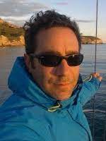
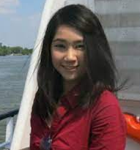
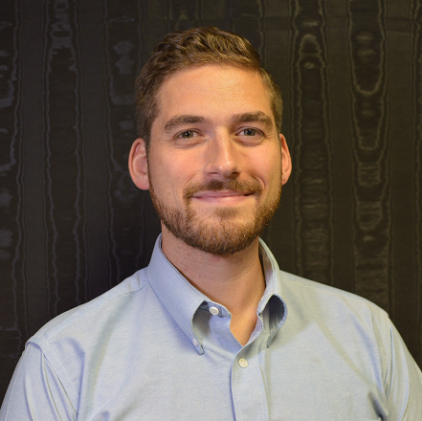
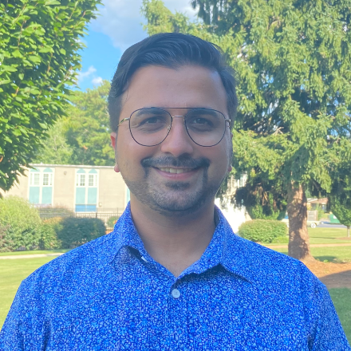
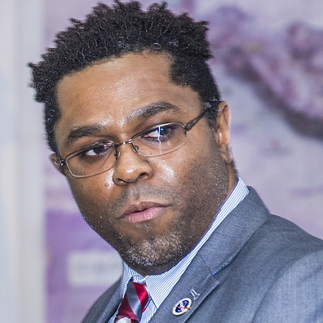
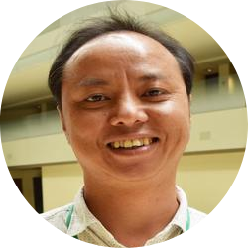
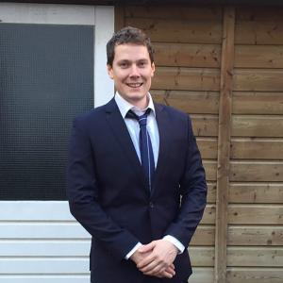

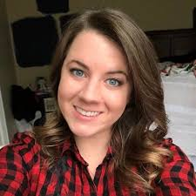
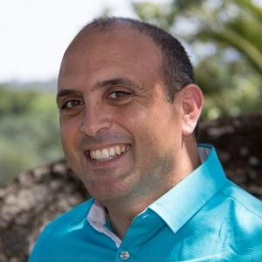
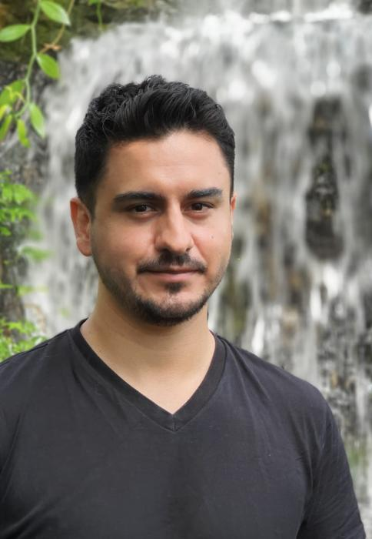
October 5, 2022
Geo For Good
Capacity building with SERVIR’s service on HYDrologic Remote Sensing Analysis for Floods (HYDRAFloods)
Tim Mayer
Biplov Bhandari
Emil Cherrington
Notes:
Speaker: Tim
Goals
Learn about how SERVIR Works
Talk about Capacity building
Training of trainers style
Build skills and get people off and running
Cut your teeth on A SERVIR Service-HydraFloods
–Colab and a Python package

Slide 2


Capacity Building
Pre-training survey
Notes:
Speaker: Tim

Slide 3
Session Outline
Outline | Duration
Pre-Survey + Start Hands-on section | 5
SERVIR’s Mission to Connect Space to Village | 5
HYDRAFloods Background | 5
What is HYDRAFloods? | 5
Hands-on Demo | 25
Example Uses | 10
Conclusions + Post Survey | 5
Total | 60
Notes:
Speaker: Tim

Slide 4
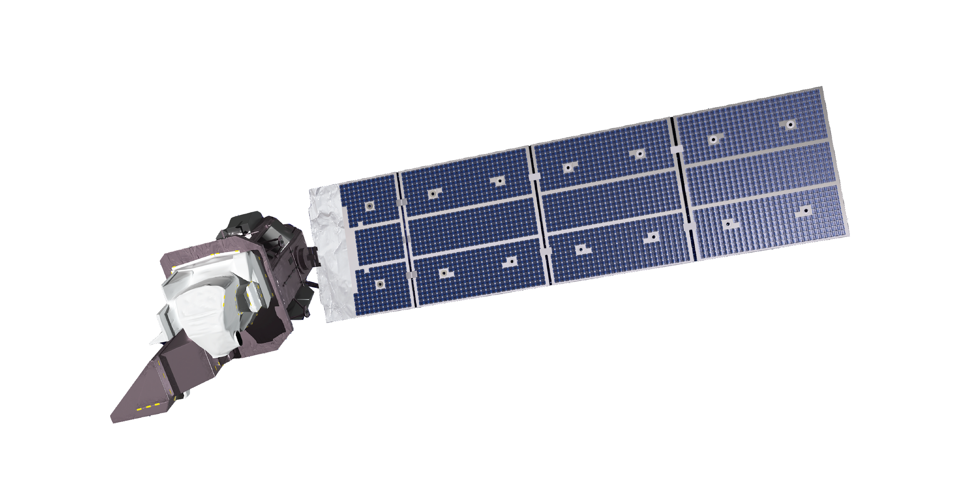









CONNECTING SPACE TO VILLAGE
SERVIR is a joint initiative of NASA, USAID, and leading geospatial organizations in Asia, Africa, and Latin America that partners with countries and organizations to address challenges in climate change, food security, water and related disasters, land use, and air quality.
Using satellite data and geospatial technology, SERVIR co-develops innovative solutions through a network of regional hubs to improve resilience and sustainable resource management at local, national and regional scales.
Notes:
Speaker: Emil

Slide 5
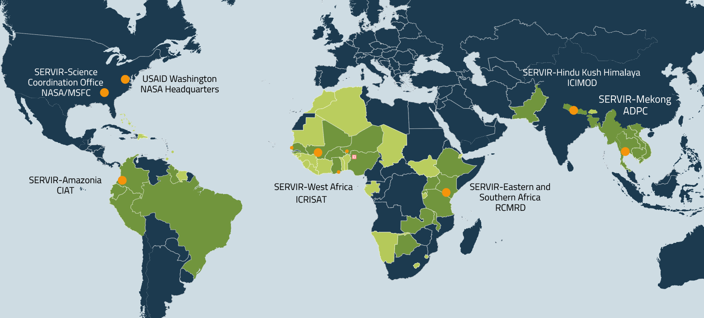
SERVIR Focuses on Countries in Asia, Africa, & the Americas
FOCUS COUNTRIES
ADDITIONAL BENEFITTING COUNTRIES
Notes:
Speaker: Emil

Slide 6
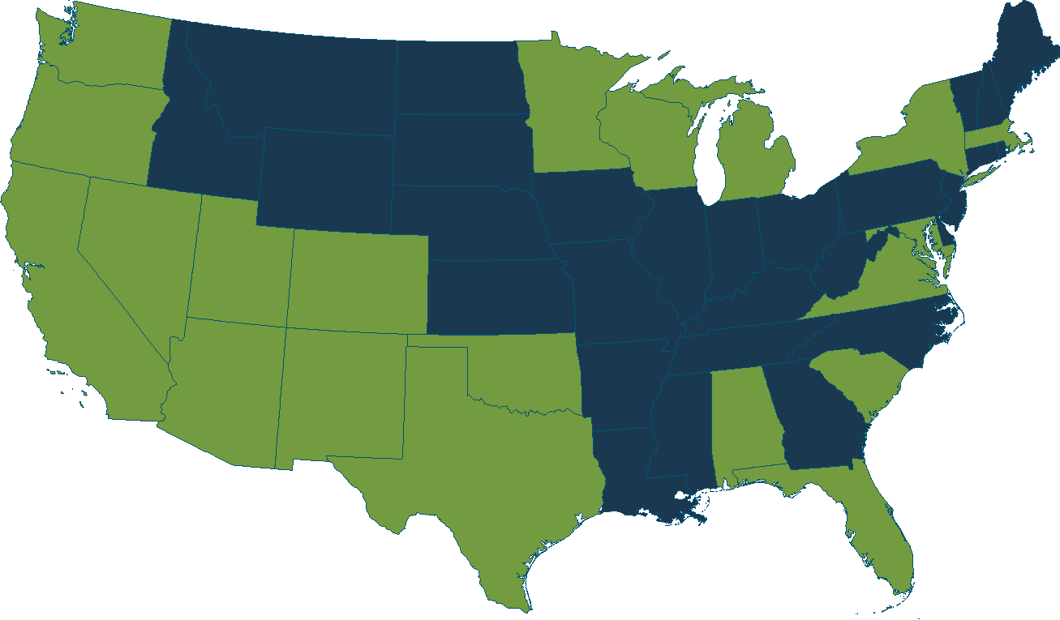
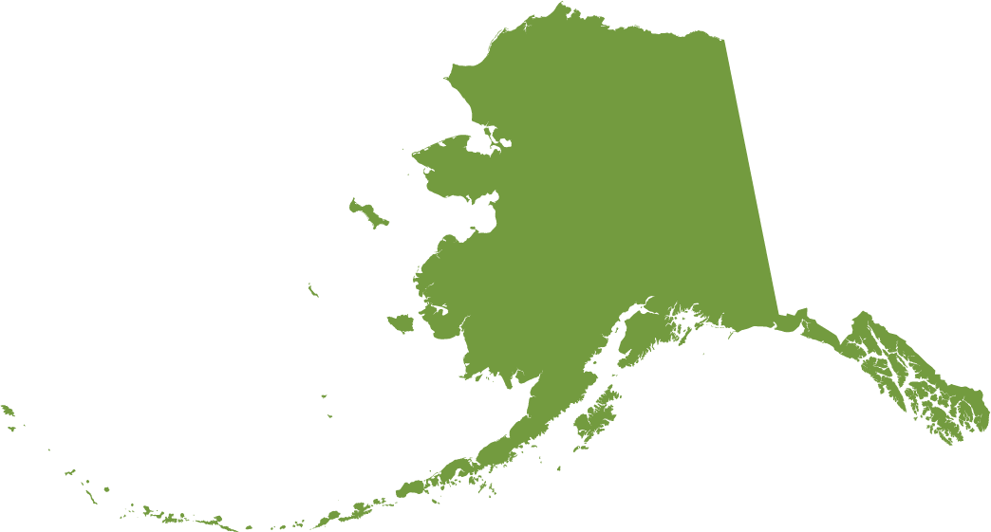
SERVIR Connects US Science to Global Development Challenges
Brigham Young University
US Forest Service, Rocky Mountain Research Station
US Geological Survey, Salt Lake City
Maxar Technologies
Univ. of Colorado, Boulder
University of Wisconsin, Madison
International Research Institute for Climate & Society
Lamont Doherty Earth Observatory
Columbia University
University of Minnesota
Michigan State University
Amazon
University of Washington
Boston University
Clark University
Earth Big Data
Univ. of Massachusetts, Amherst
Woods Hole Research Center
Oregon State University
US Forest Service, PNW Research Station
Desert Research Institute
Johns Hopkins University
NASA Goddard Space Flight Center
University of Maryland
Univ. of Maryland, Baltimore County
Univ. of Maryland, College Park
USRA, Columbia
Columbus Technologies
ESRI
Google
Mapbox
NASA Jet Propulsion Laboratory
Spatial Informatics Group, LLC
University Of California, Los Angeles
University Of California, Santa Barbara
University of California, Berkeley
University of California, Irvine
University of San Francisco
DevSeed
Resources For The Future, Inc.
World Wildlife Fund
George Mason University
US Agency for International Development
USGS, Eastern Geographic Science Center
University of Richmond
Geospatial Collaborative LLC
New Mexico State University
University of South Carolina
IFDC
NASA Marshall Space Flight Center
NASA SPoRT Center/ENSCO
Universities Space Research Association
University of Alabama in Huntsville
University of Florida, Gainesville
Alaska Satellite Facility
University of Alaska Fairbanks
University Of Houston
Texas Agricultural Experiment Station
NOAA/National Severe Storms Laboratory
University of Oklahoma, Norman
Notes:
Speaker: Emil

Slide 7


































Who Is SERVIR?
Private sector collaborators:
Poverty reduction & resilience
Data-dependent issues in data-scarce places
International field presence
USG collaborators:
30+ Earth observing satellite missions, free & open data
Major research portfolio
Societal benefit from space
Intergovernmental, NGO collaborators:
Regional Hub Host Institutions:
Research collaborators: 20+ US universities & research centers through the SERVIR Applied Sciences Team; ITC, in-region university networks
Hub Consortium Members:
Notes:
Speaker: Emil

Slide 8

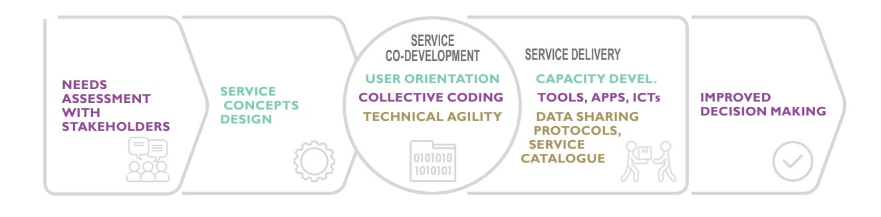
Geospatial Co-Development

Slide 9




CONNECTING SPACE TO VILLAGE
Agriculture & Food Security
Water & Water- Related Disasters
Land Cover, Land Use Change & Ecosystems
Weather & Climate
ALLIANCE
Notes:
Speaker: Emil

Slide 10

Colab Notebook
***Copy a version to your drive***

Slide 11
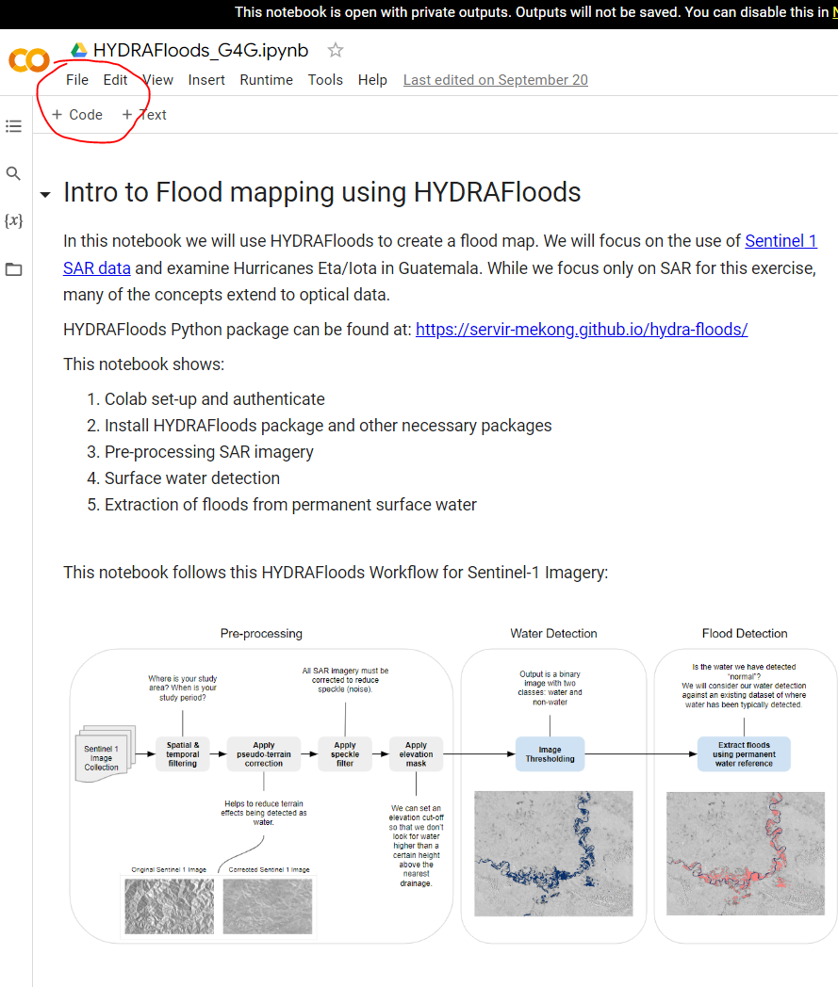
Colab Set-up
Copy the notebook to your drive
-
File: “Save a copy to my Drive”
Notes:
Speaker: Tim

Slide 12
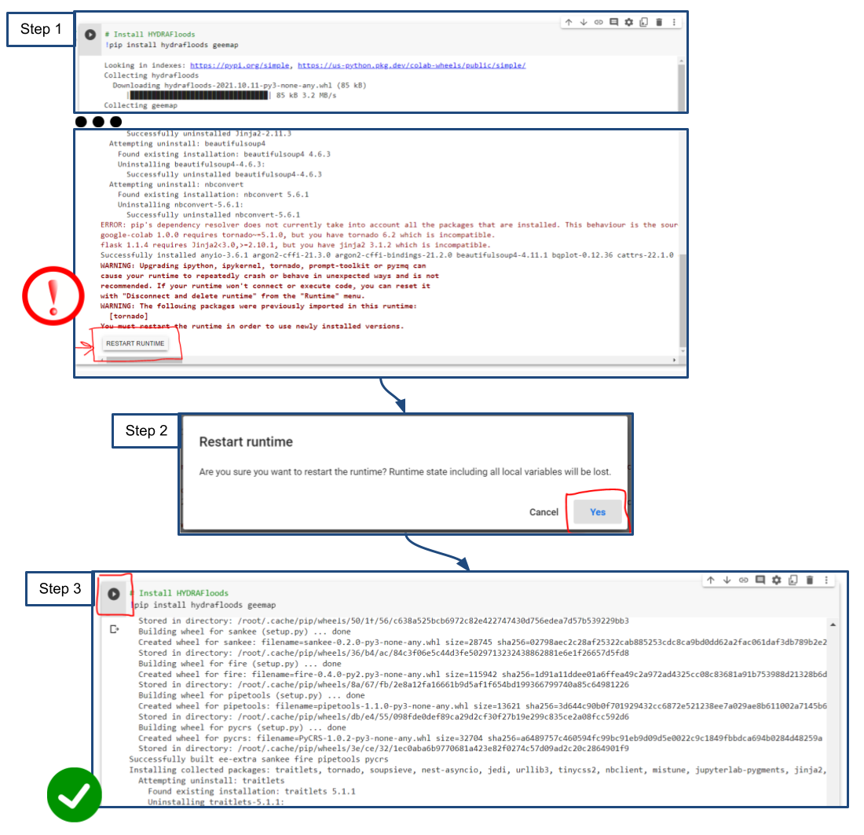

Colab Set-up: Restart runtime
Restart runtime
-
Circle back
-
pip install hydrafloods geemap: Cell #1

Slide 13
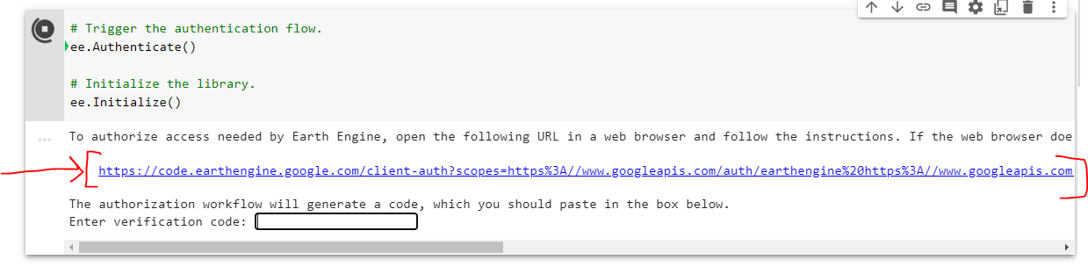
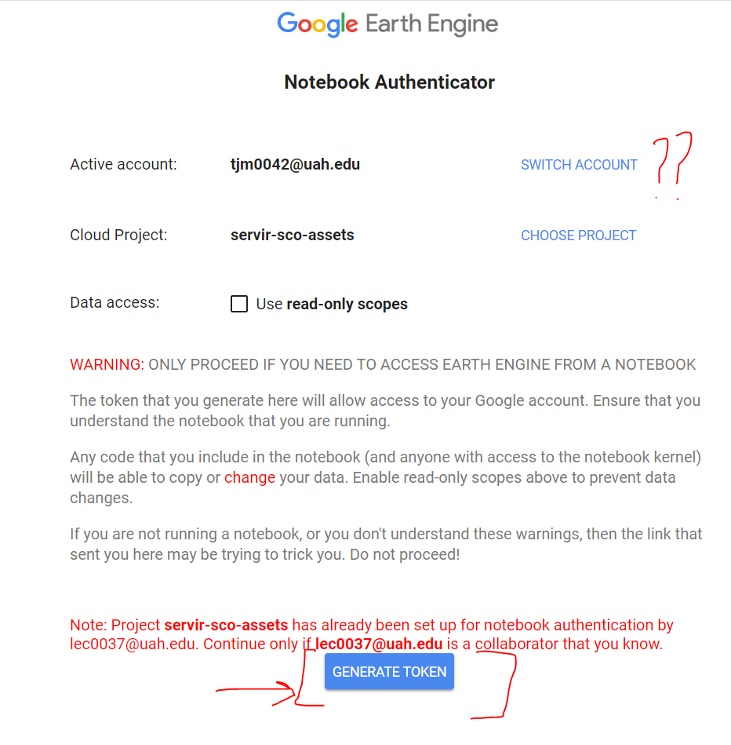
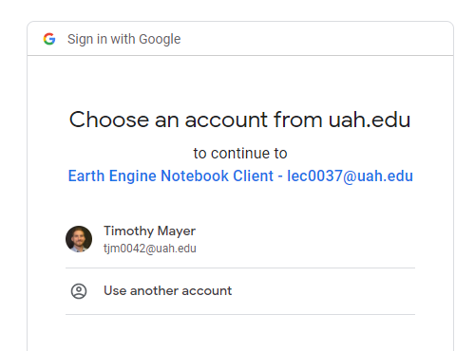
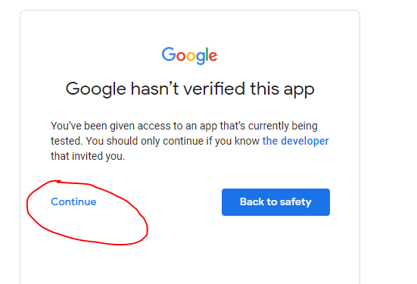
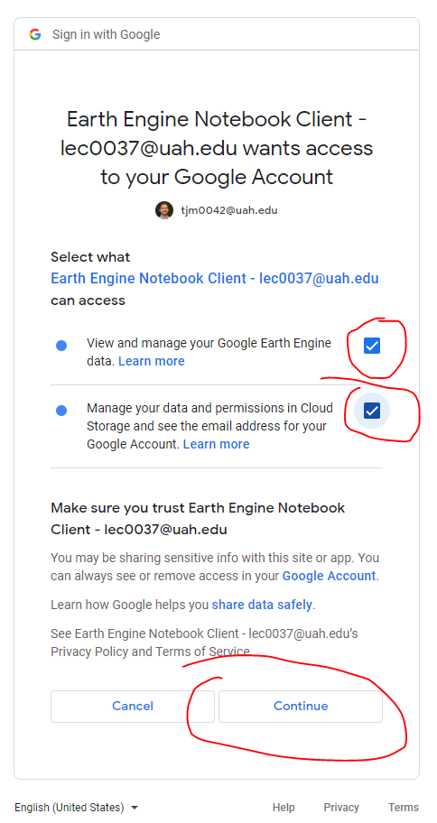
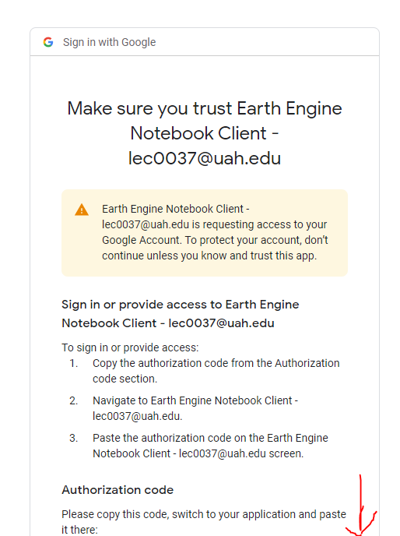
Colab Set-up: Authentication “Road Map”
Step 1
Step 2
Step 3
Step 4
Step 5
Step 6
Copy Authorization Code
Step 7
Paste Authorization Code
Notes:
Speaker: Tim

Slide 14
Colab Set-up: Authentication “Road Map”
Step 2
Step 1
Notes:
Speaker: Tim

Slide 15
Colab Set-up: Authentication “Road Map”
Step 3
Step 4
Notes:
Speaker: Tim

Slide 16
Colab Set-up: Authentication “Road Map”
5
6
Copy Authorization Code

Slide 17
Colab Set-up: Authentication “Road Map”
Step 7
Paste Authorization Code
Notes:
Speaker: Tim

Slide 18
Lets run the code and talk application
Notes:
Speaker: Tim

Slide 19
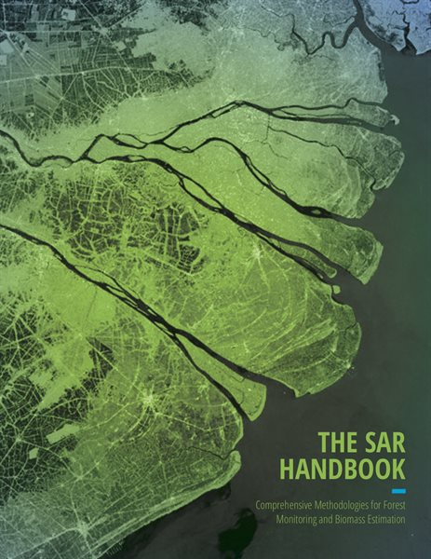
Knowledge Check-in
How familiar are you with SAR and specifically Sentinel-1 ?
-
Resources: SAR Handbook
Notes:
Speaker: Tim

Slide 20
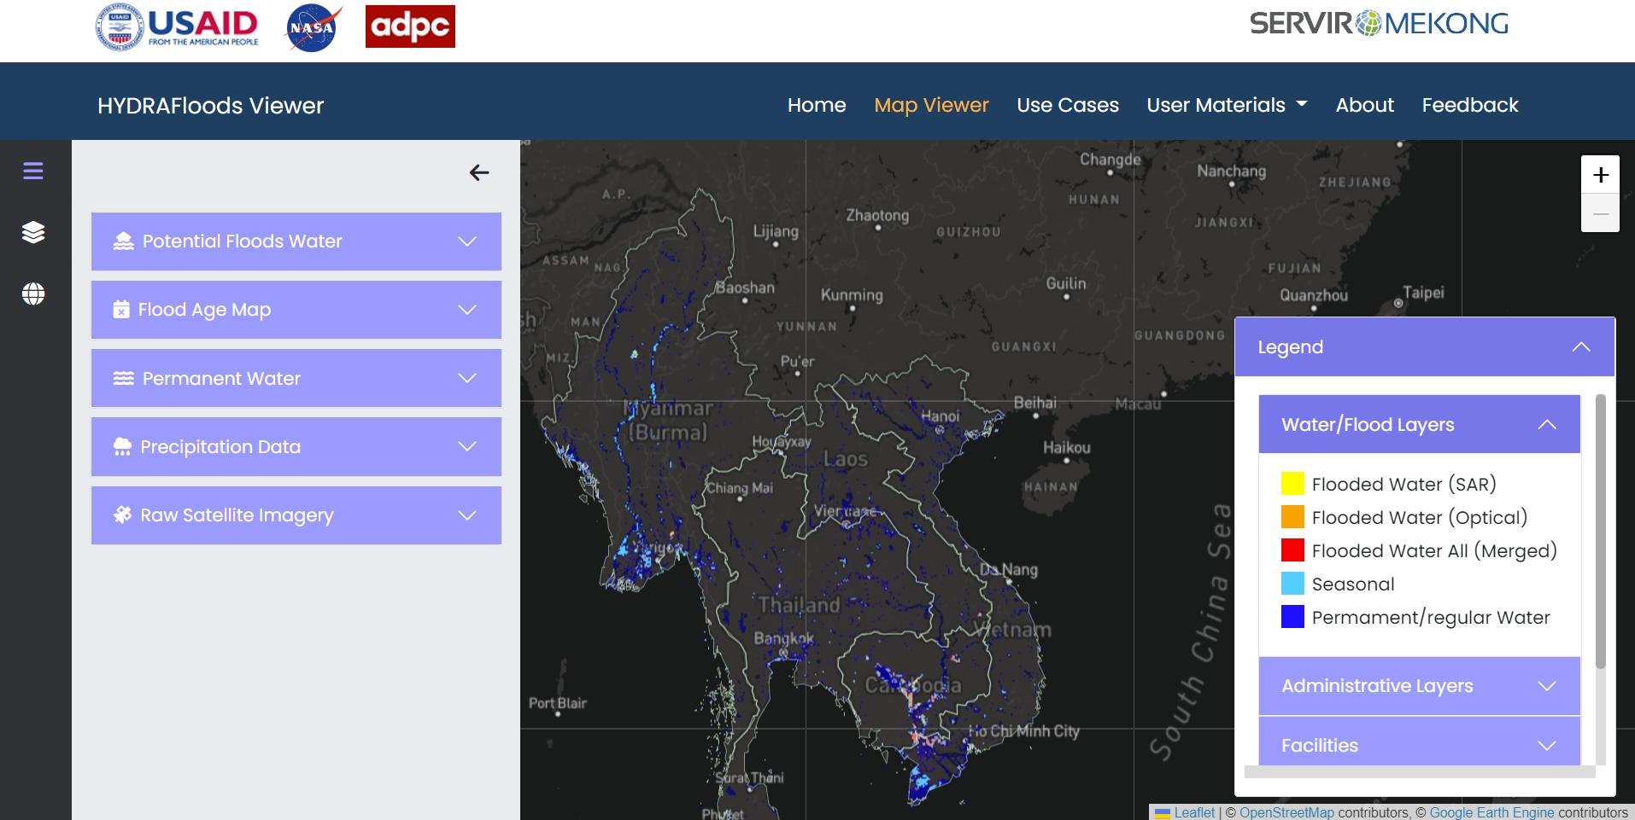
HYDRAFloods
HYDrologic Remote Sensing Analysis for Floods
Notes:
Speaker: Biplov

Slide 21
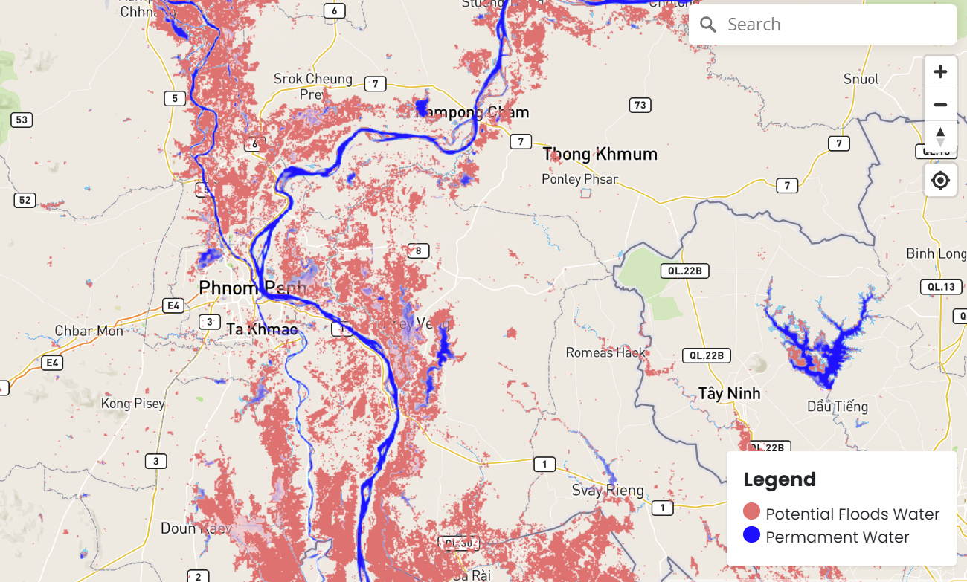
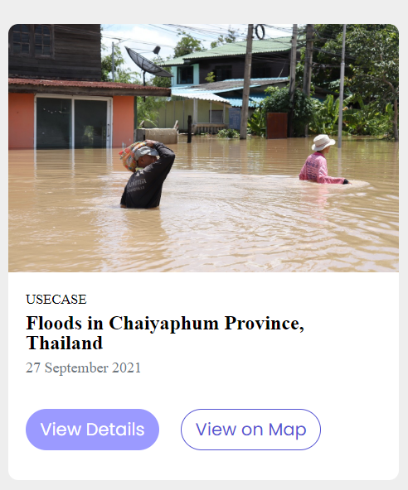
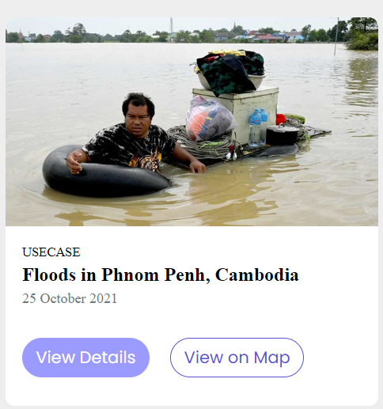
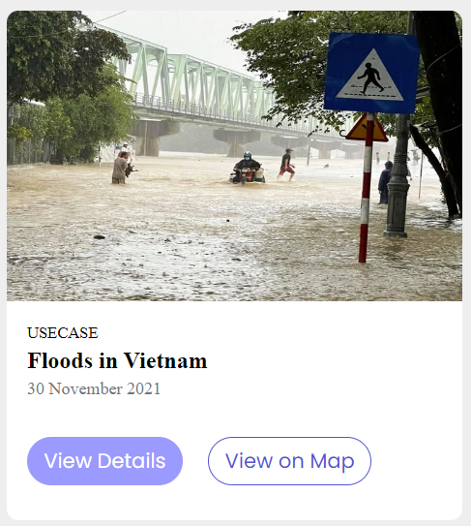
HYDRAFloods
The publicly available, web-based service delivering near real-time information for improved flood monitoring.
Designed to provide information on flood location and extent to assist with flood preparedness, emergency response and relief efforts.
Provide information to users on:
The extent of flooded areas
Possible severity of flood (e.g., depth, duration, age)
Notes:
Speaker: Biplov

Slide 22
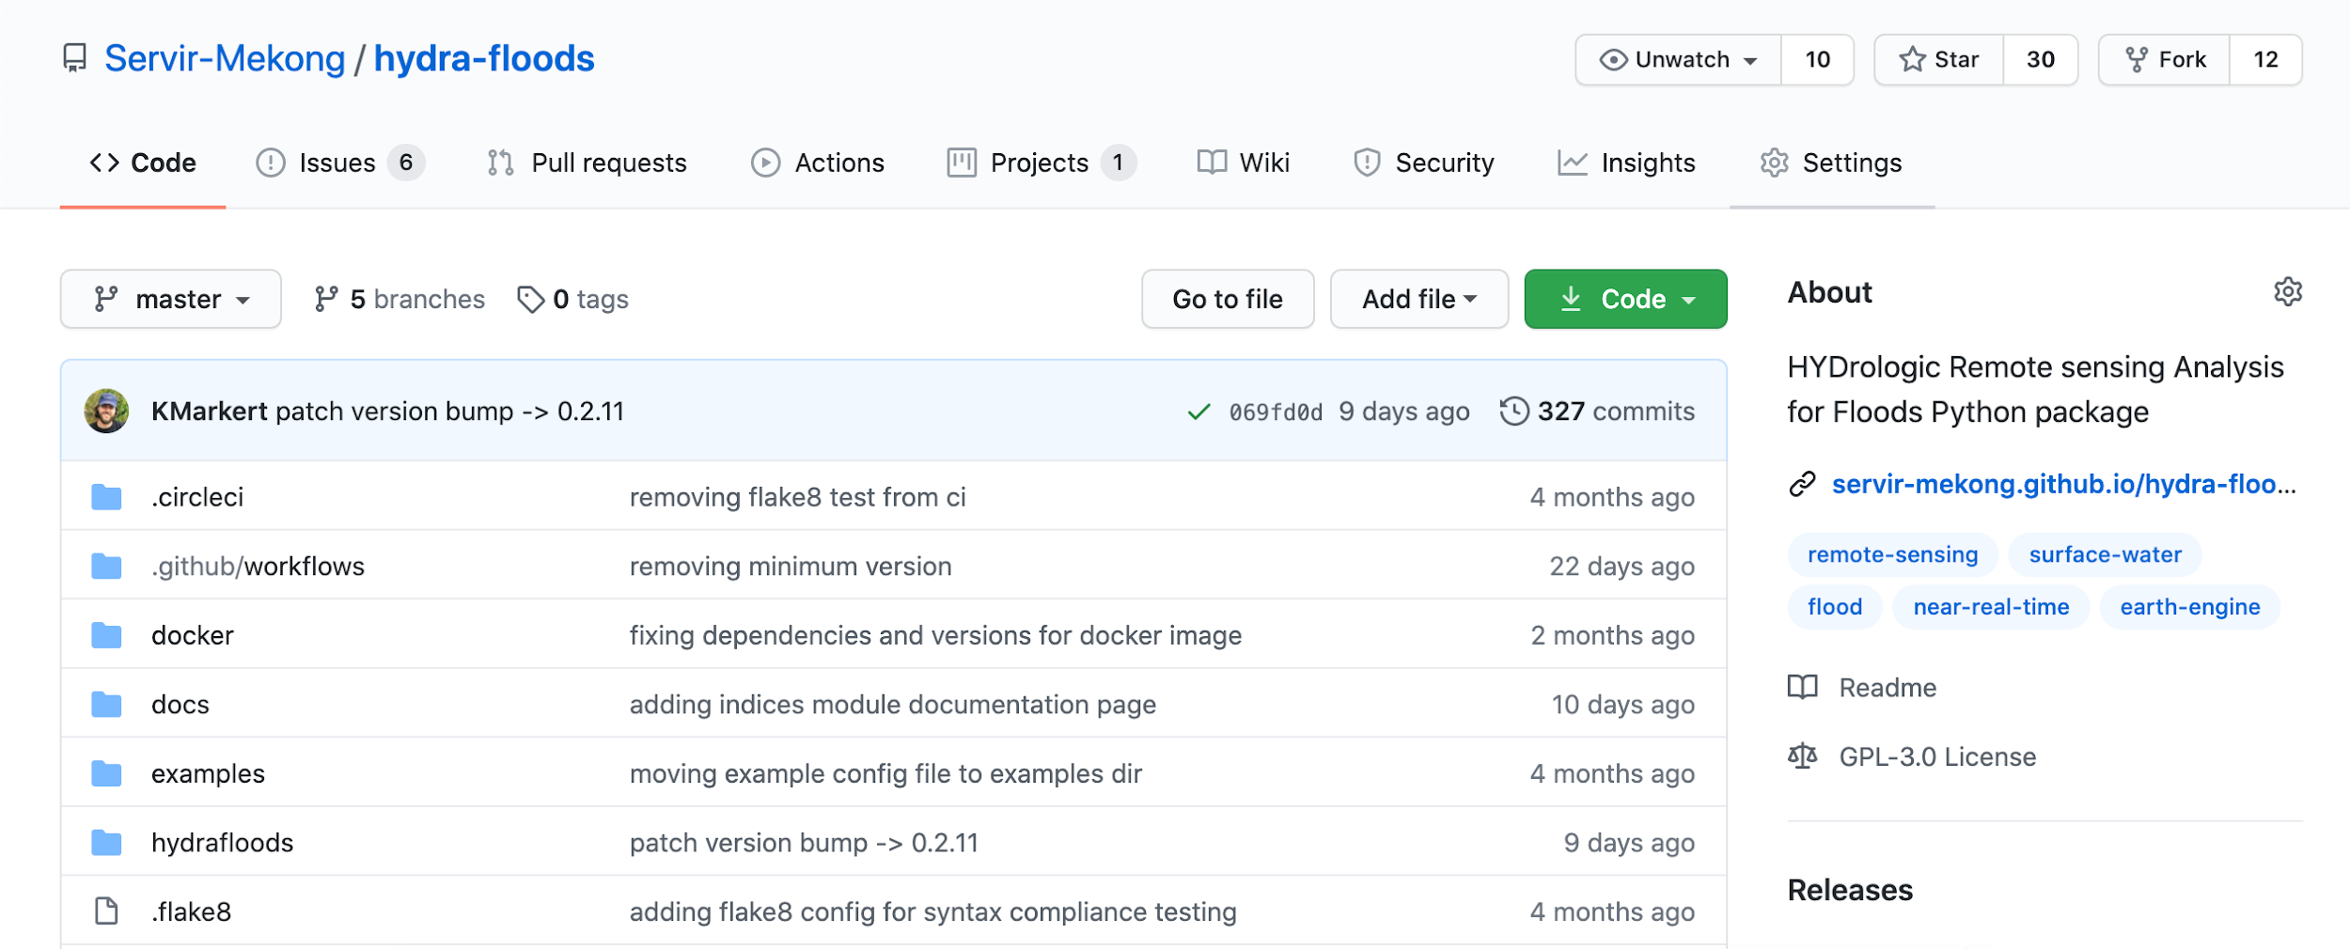
What is HYDRAFloods?
Open Source - anyone can use and modify for FREE!!!
Documented to increase transparency
Notes:
Speaker: Biplov

Slide 23
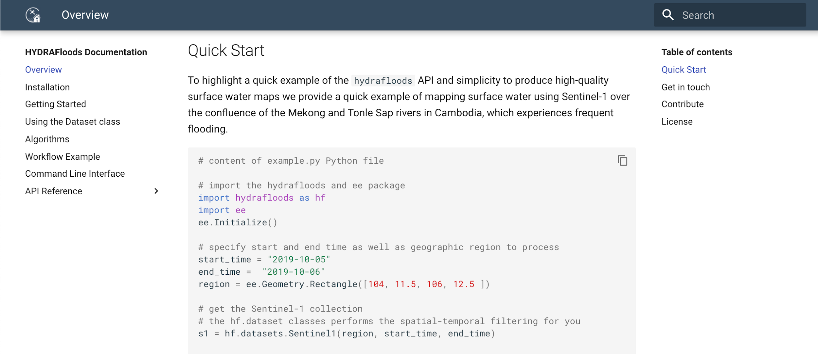
What is HYDRAFloods?
Documented to increase transparency
Notes:
Speaker: Biplov

Slide 24
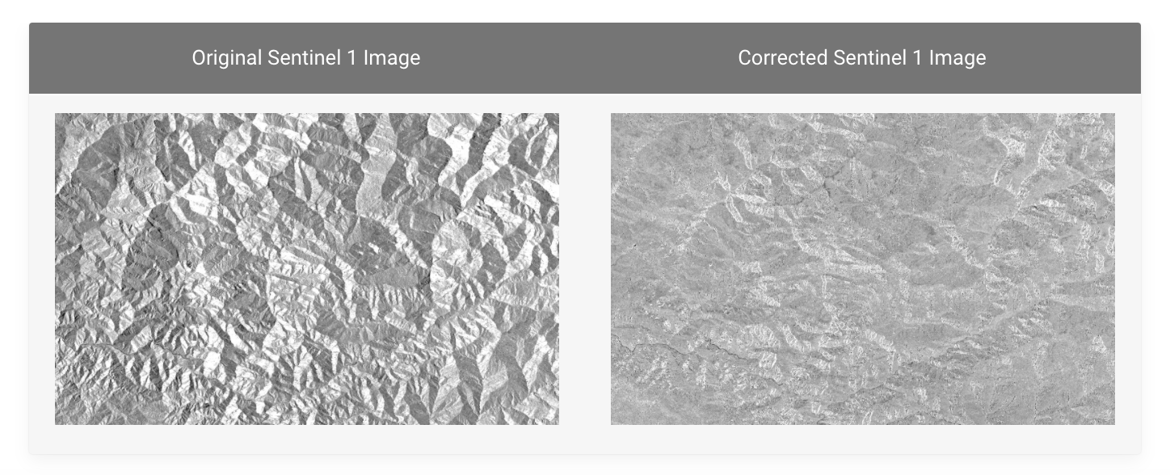
What is HYDRAFloods?
Cloud-based - overcome big data challenges
Built on top of Google Earth Engine and Google Cloud ecosystem
End-to-End processing - users have all the tools needed to create their own high quality surface water map
QA masking
SAR speckle filters
Terrain correction (SAR and Optical)
Time series processing
Machine learning workflows
Multi-sensor water mapping algorithms
Notes:
Speaker: Biplov

Slide 25
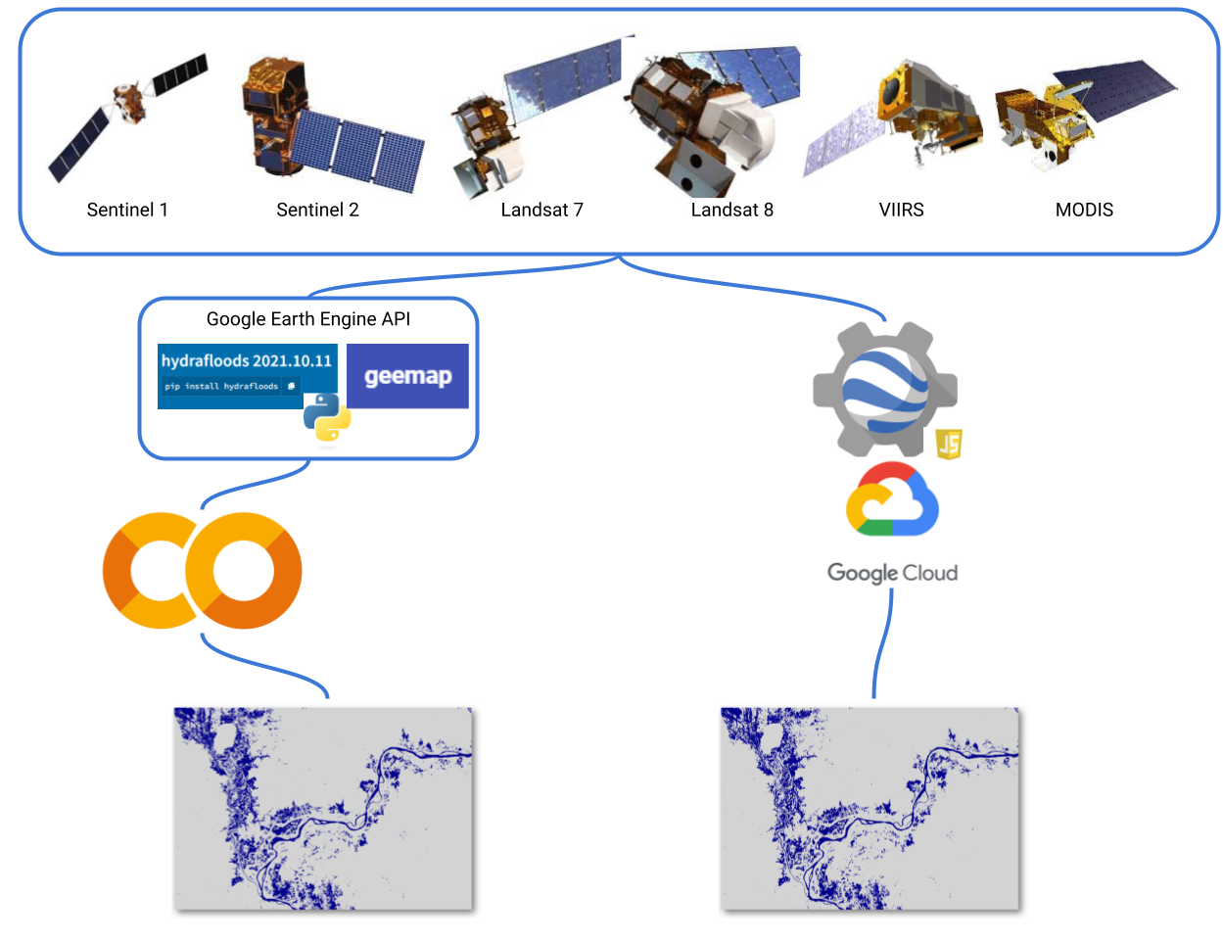
What makes HYDRAFloods powerful?
Flood Maps can be generated from an array of sensors
Making it powerful to combat temporal gaps
Is built in GEE and Python for end-user ease of use
Notes:
Speaker: Biplov

Slide 26

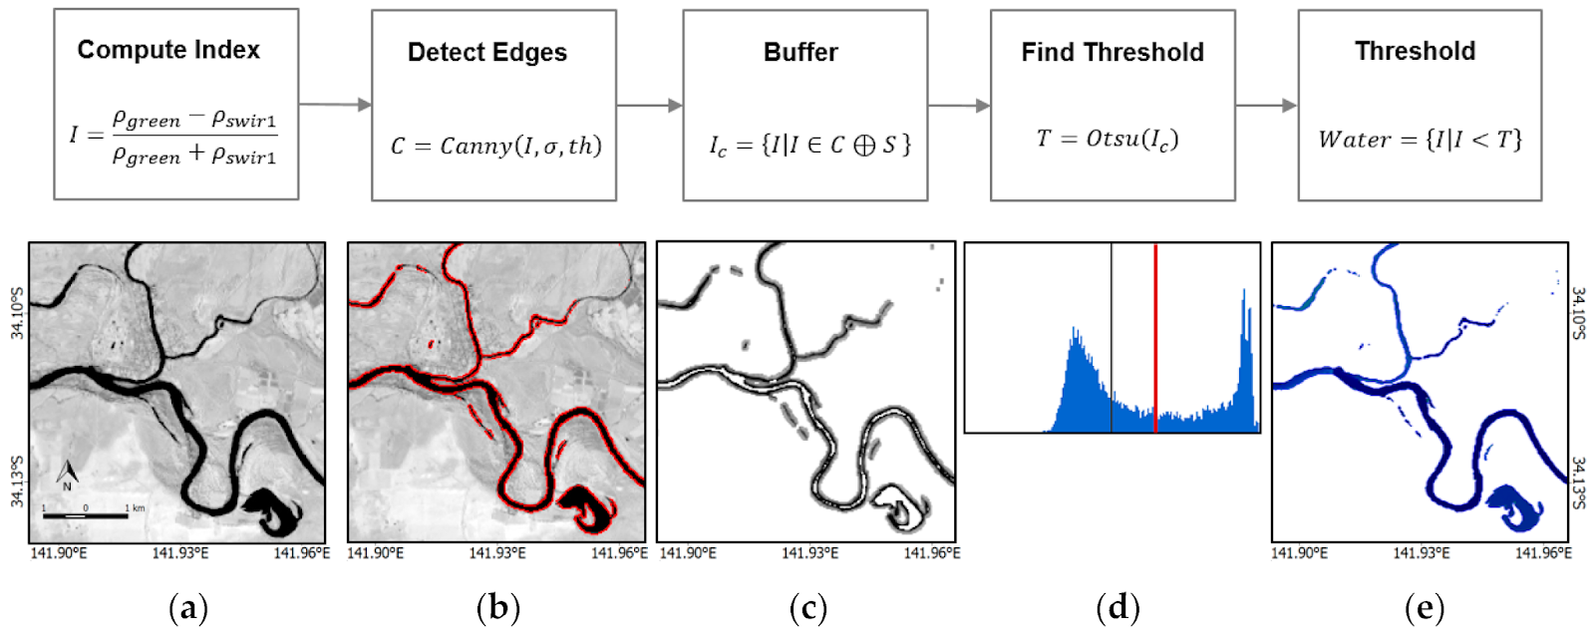
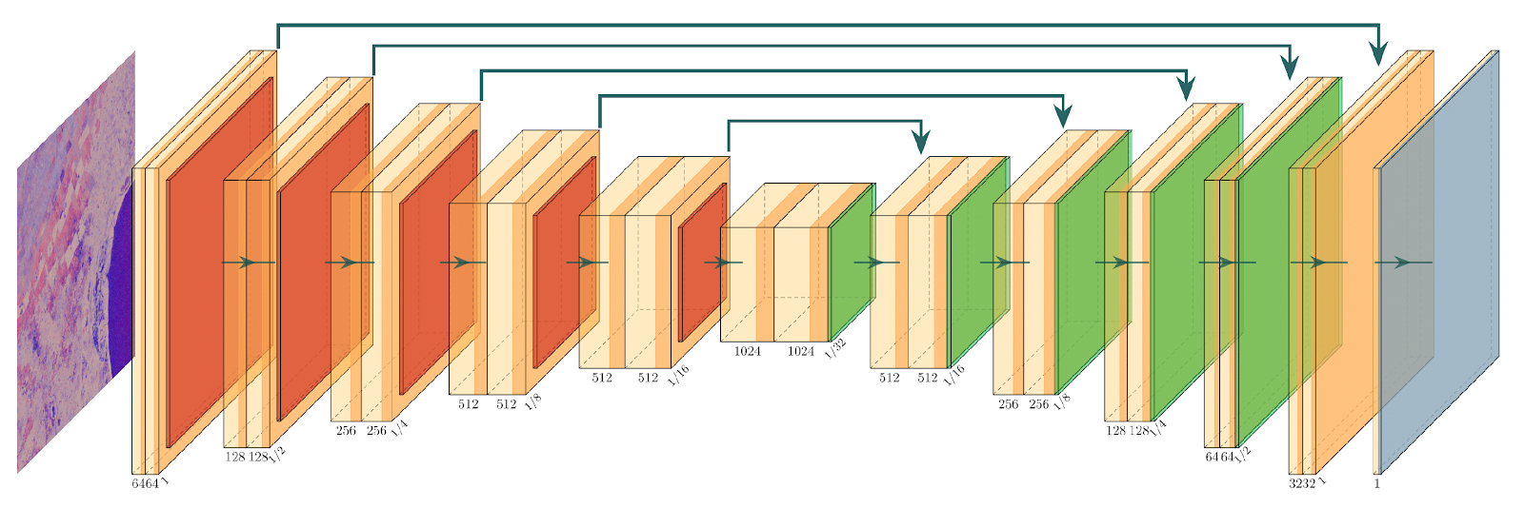
Background: Science
Single sensor (flood) maps
Sentinel-1
Sentinel-2
Landsat 8
Daily data fused (flood) maps
all
Otsu
optical
based on Donchyts et al. (2016), Application: Markert et al. (2020)
QA UNet
based on Hughes et al. (2019), Application: Mayer et al. (2021)
Notes:
Speaker: Biplov

Slide 27
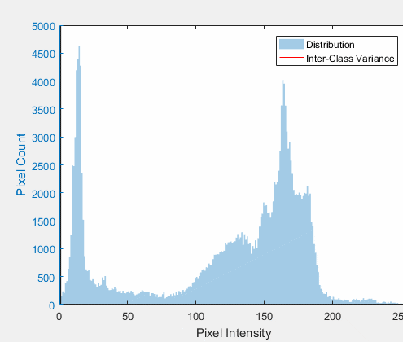
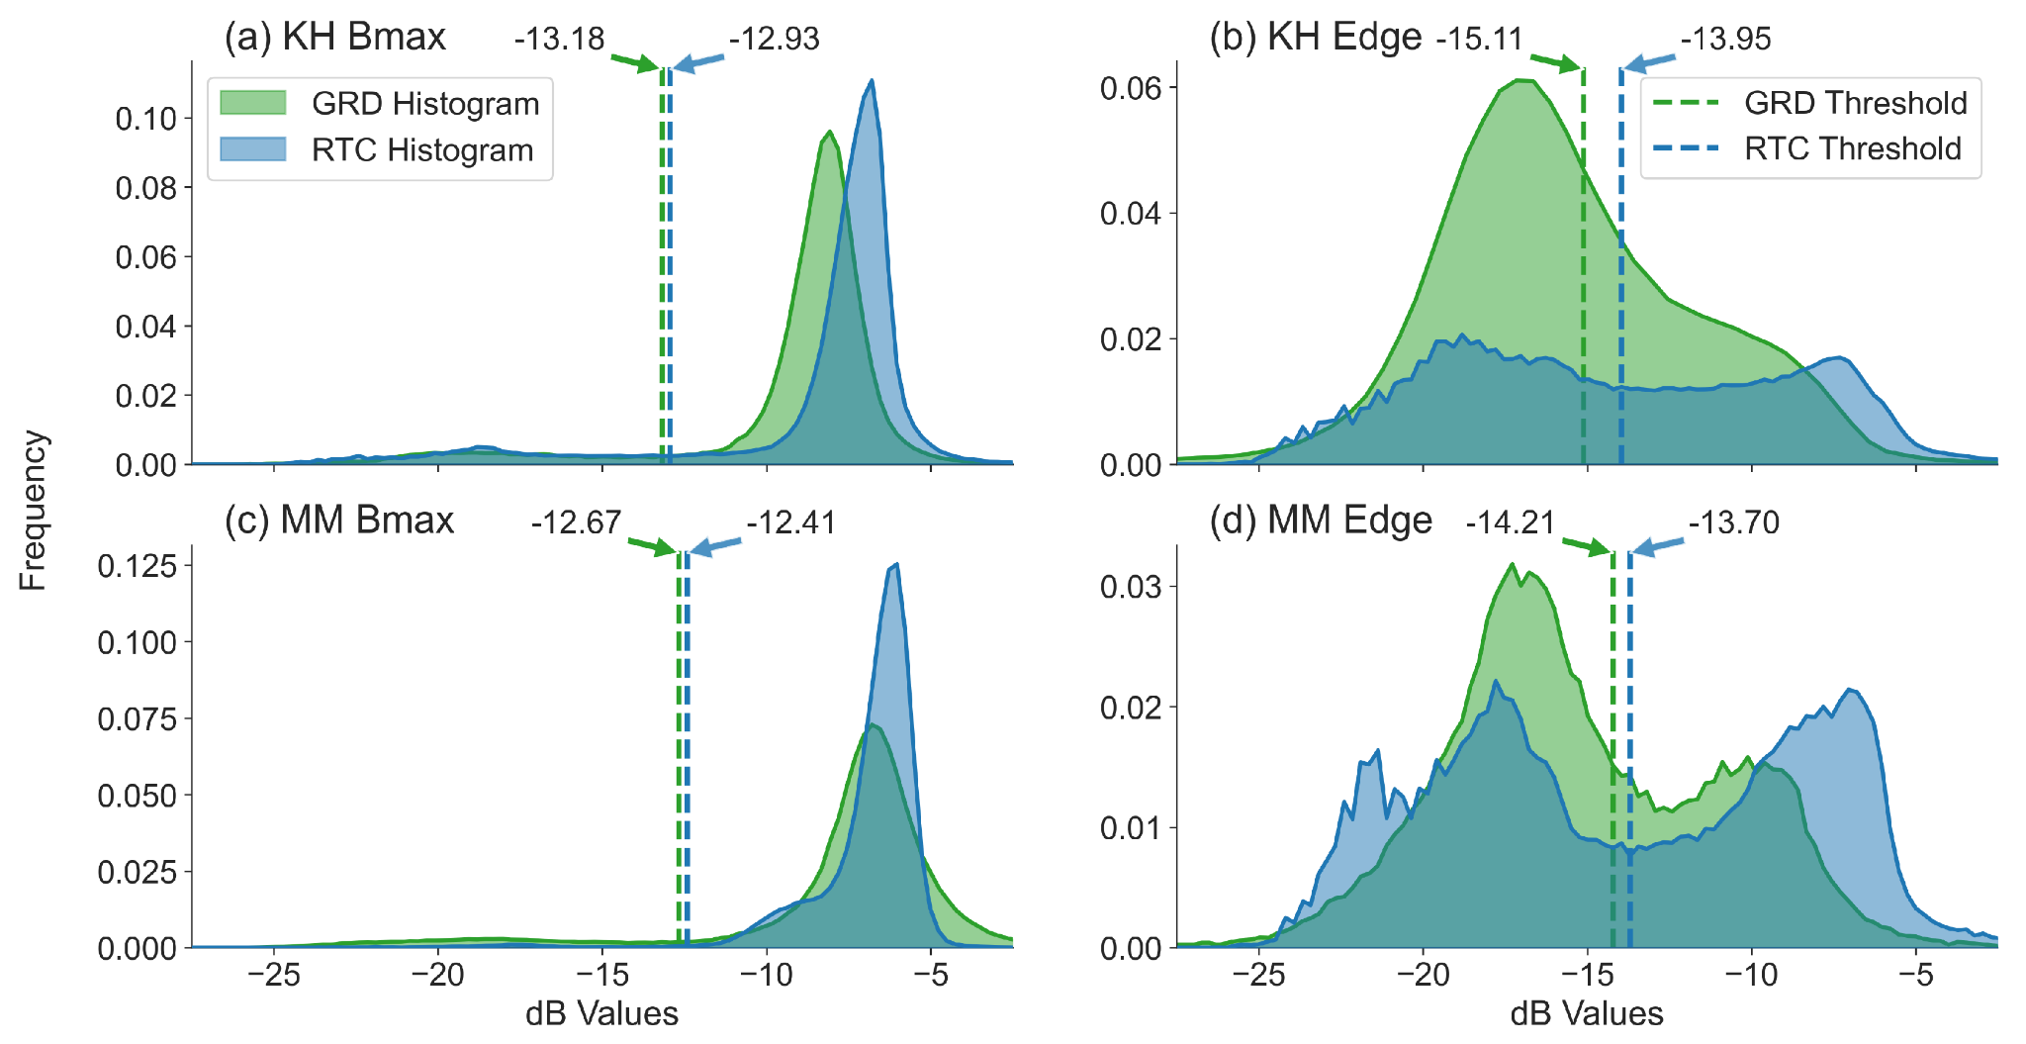
Thresholding Algorithm
Otsu’s Thresholding
Automated histogram-based thresholding approach
Maximizes inter-class variance between two classes
Assumes there are only two classes, a background and foreground
Markert et al. (2020)
Notes:
Speaker: Biplov
CC BY-SA 3.0, https://en.wikipedia.org/wiki/Otsu%27s_method#/media/File:Otsu's_Method_Visualization.gif

Slide 28
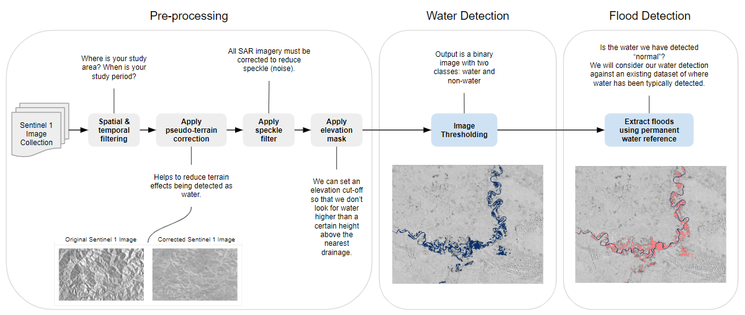
HYDRAFloods S-1 Flood detection workflow
Notes:
Speaker: Biplov
SAR Preprocessing
Apply terrain correction using DEM
Apply gamma map speckle filtering
Used specific threshold (-15.5) to segment two classes: land and water grids
Create histogram to calculate min and max threshold
Calculate midpoint of min and max threshold using Fuzzy_Gaussian to get surface water layer
Post-processing
JRC historical water Layer

Slide 29
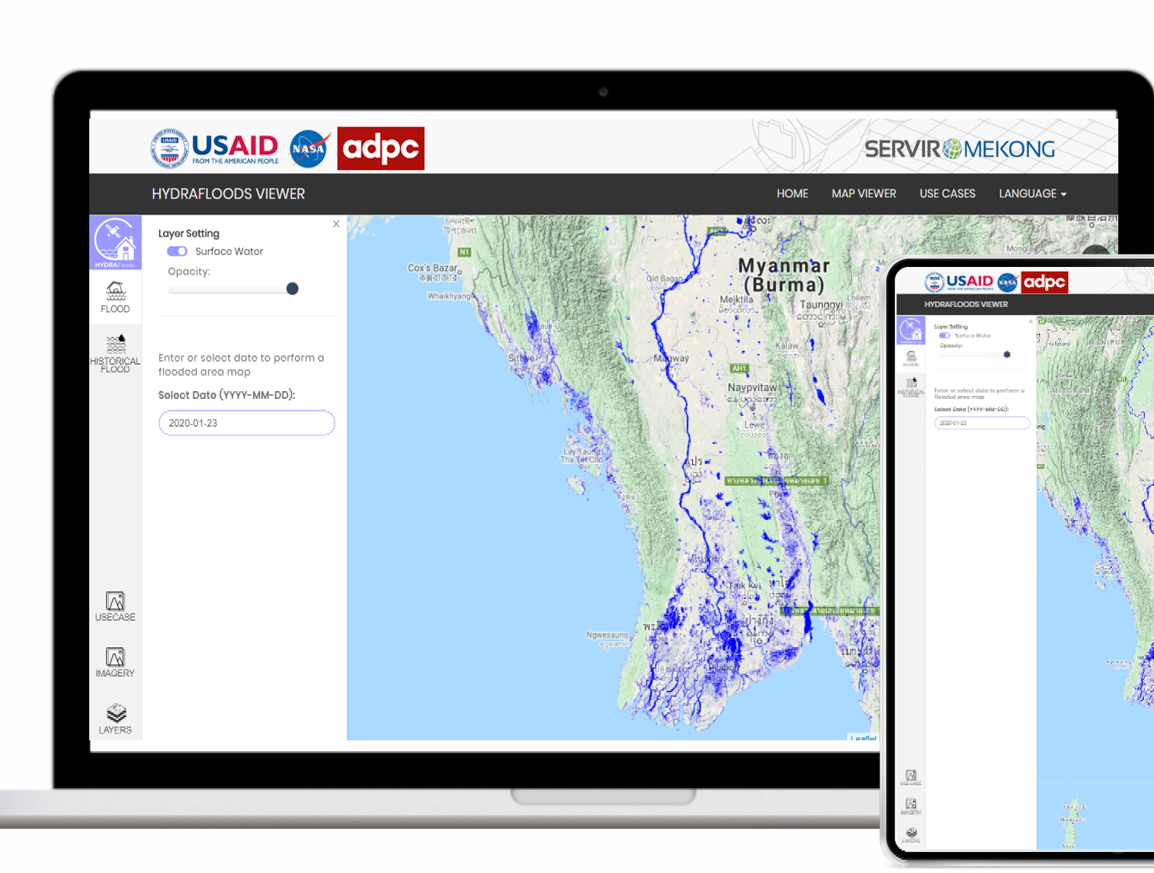

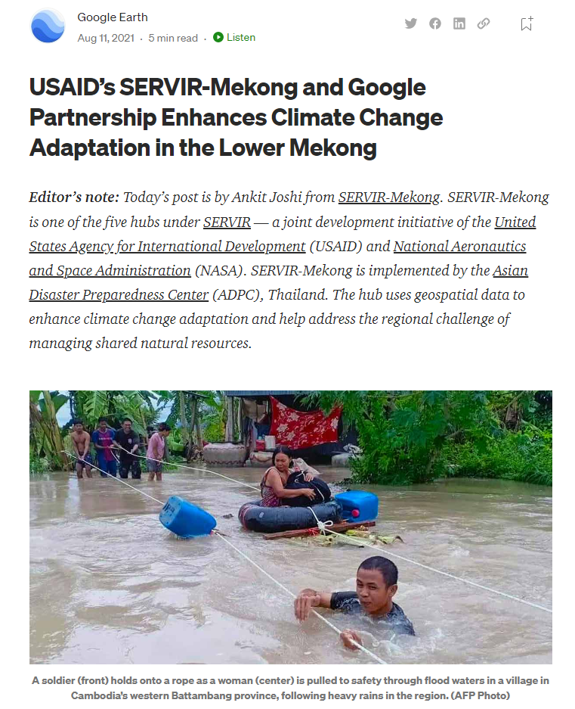
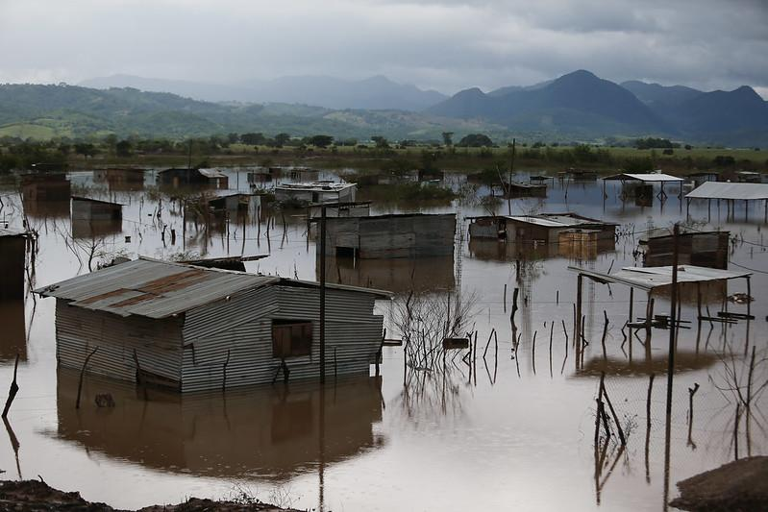
SERVIR Method Transfer
Replicating Flood Maps Across Southeast Asia
HYDRAFloods has been replicated from Myanmar to Cambodia to prioritize food assistance in the face of floods via the World Food Programme (WFP)
Central America Example
On November 3, Eta made landfall on the Caribbean coast of Nicaragua as a category 4 hurricane, followed by Iota on November 14 as a category 5 hurricane.
The compounding storms’ reach extended throughout Central America, with heavy flood impacts in Nicaragua, Honduras, and Guatemala.
An estimated 7.5 million people were affected across Central America
Source: Relief Web
Photo: European Union 2020, D. Membreño on Flikr
Notes:
Speaker: Biplov

Slide 30
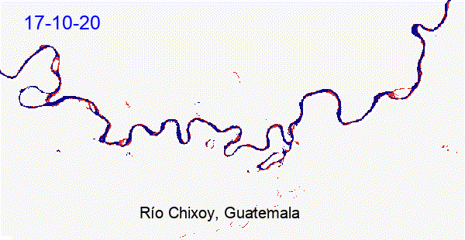
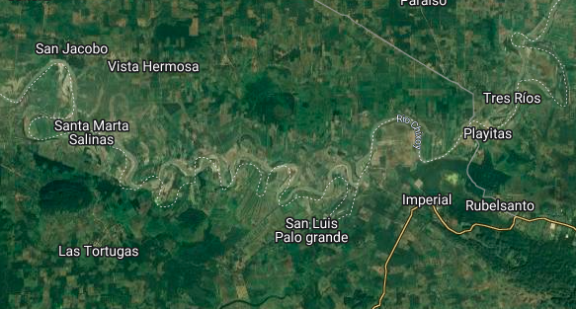
Hurricanes Eta & Iota
Central America example of flood detected from Sentinel-1 using HYDRAFloods
Detected flood
Permanent water
Notes:
Speaker: Biplov

Slide 31
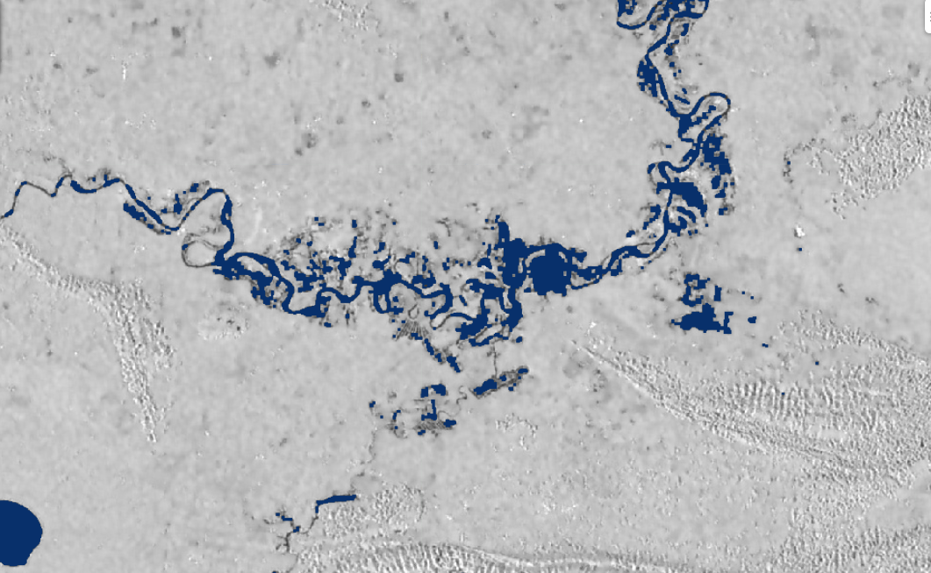
Let's revisit the code
Notes:
Speaker: Biplov

Slide 32
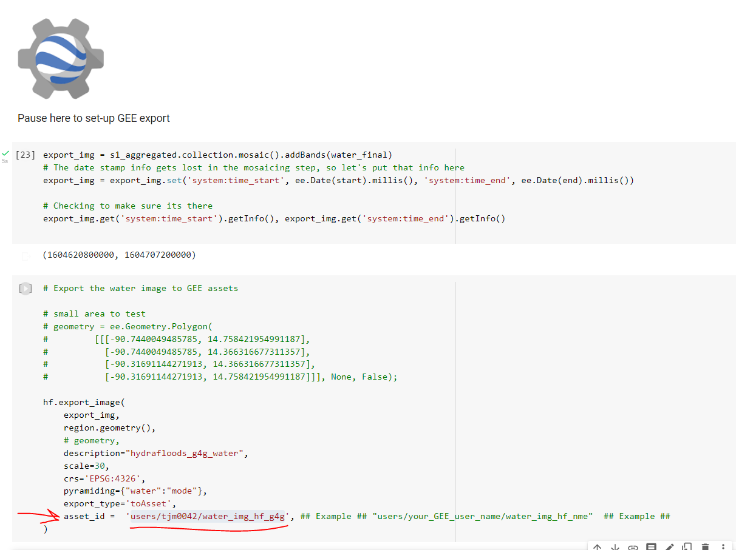

Explore in GEE
Google Earth Engine Example
Notes:
Speaker: Tim

Slide 33
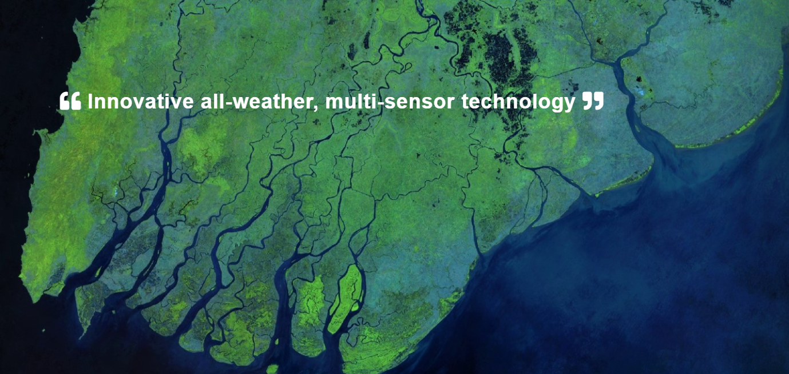
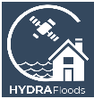






One Stop Shop
HYDRAFloods
Open Science
Open Source
Web portal with analytics
Dedicated data streams
Capacity building
Notes:
Speaker: Tim

Slide 34



HF Operational Flowchart
HYDRAFloods SERVIR-Mekong Website
Notes:
Speaker: Tim

Slide 35

Applications of HYDRAFloods
WFP Cambodia
Currently providing merged water classification layers from multiple sensors
Provide multi sensor surface water maps
Uses machine learning and deep learning methods

Slide 36



Explore SERVIR-Mekong HYDRAFloods Website
HYDRAFloods SERVIR-Mekong Website
Explore the interface
Use Date: 9/27/2022
Zoom to
Preah Netr Preah Bântéay Méanchey, Cambodia
Notes:
Speaker: Tim

Slide 37
Conclusions
What this provides
Daily wall-to-wall maps as high as 10m resolution of estimated surface water
Ability to support surface water as daily basis
What this cannot provide
Will not capture flash-floods or dam breaks as instantaneous events will not be in time series
These are estimated water maps so may not align exactly with observations
Notes:
Speaker: Tim

Slide 38

Interested in more Capacity Building?
TensorFlow Working Group
Notes:
Tim

Slide 39
Capacity Building
Post-training survey
Notes:
Speaker: Tim

Slide 40
Thank you to the rest of the SERVIR Science Coordination Office, SERVIR Hubs, and Applied Science Team that make all of these services possible.
Thank You
Tim Mayer
Biplov Bhandari
Emil Cherrington
For further questions, please contact:
timothy.j.mayer@nasa.gov
biplov.bhandari@nasa.gov
emil.cherrington@nasa.gov
Notes:
Speaker: Tim

Slide 41









SERVIRglobal.net

Slide 42

Methods, Algorithms, and Science Co-Development
Daily Surface Water Fusion Process (DSWFP)
SAR Speckle Filtering Algorithms
Generic Water Mapping Algorithms
Flood Water Depth Estimation Tool
-
Cohen et al. 2019 | Peter et al. 2020
Deep Learning: Visual Geometry Group (VGG) 19 model architecture
Etc.
Notes:
Speaker: Biplov
PublicDomainPictures / 17901 images

Slide 43





HF used in Central America
HYDRAFloods supported regional authorities’ impact assessment of agricultural lands through mapped flood extent.
The workflow can be adjusted to the needs of future users.
Notes:
Speaker: Biplov
In 2020, regional authorities used HYDRAFloods to map flooded agricultural areas after the hurricanes
GEOGLoWs was also used in conjunction with HYDRAFloods to manage water release from a large dam in Honduras (El Cajon)
In 2021, DEVELOP partnered with regional authorities (CRRH - the regional Hydromet org and CEPREDENAC - the regional disasters coordination org) to create post-disaster case study analysis using HYDRAFloods.
An overview the DEVELOP feasibility study can be found in the ARSET course: Monitoring and Modeling Floods using Earth Observations

Slide 44


Set-up in Colab
Notes:
Speaker: Biplov

Slide 45


Algorithms: Change Detection
Pre-event and post-event change detection using logarithmic amplitude ratio (LAR).
Notes:
Speaker: Biplov

Slide 46

Sentinel-2 QA Model

Slide 47

Additional Example Uses
Deltares Flood Impact Analysis on Road Networks
Used to understand how floods can potentially affect road networks and peoples access to critical services

Slide 48

Methods, Algorithms, and Science Co-Development
Leverage multiple sensors easily with common syntax and data fusion workflows.
Notes:
Speaker: Biplov

